Slide 1
RDM in Jupyter
The Importance of Keeping your Data Reproducible

Slide 2
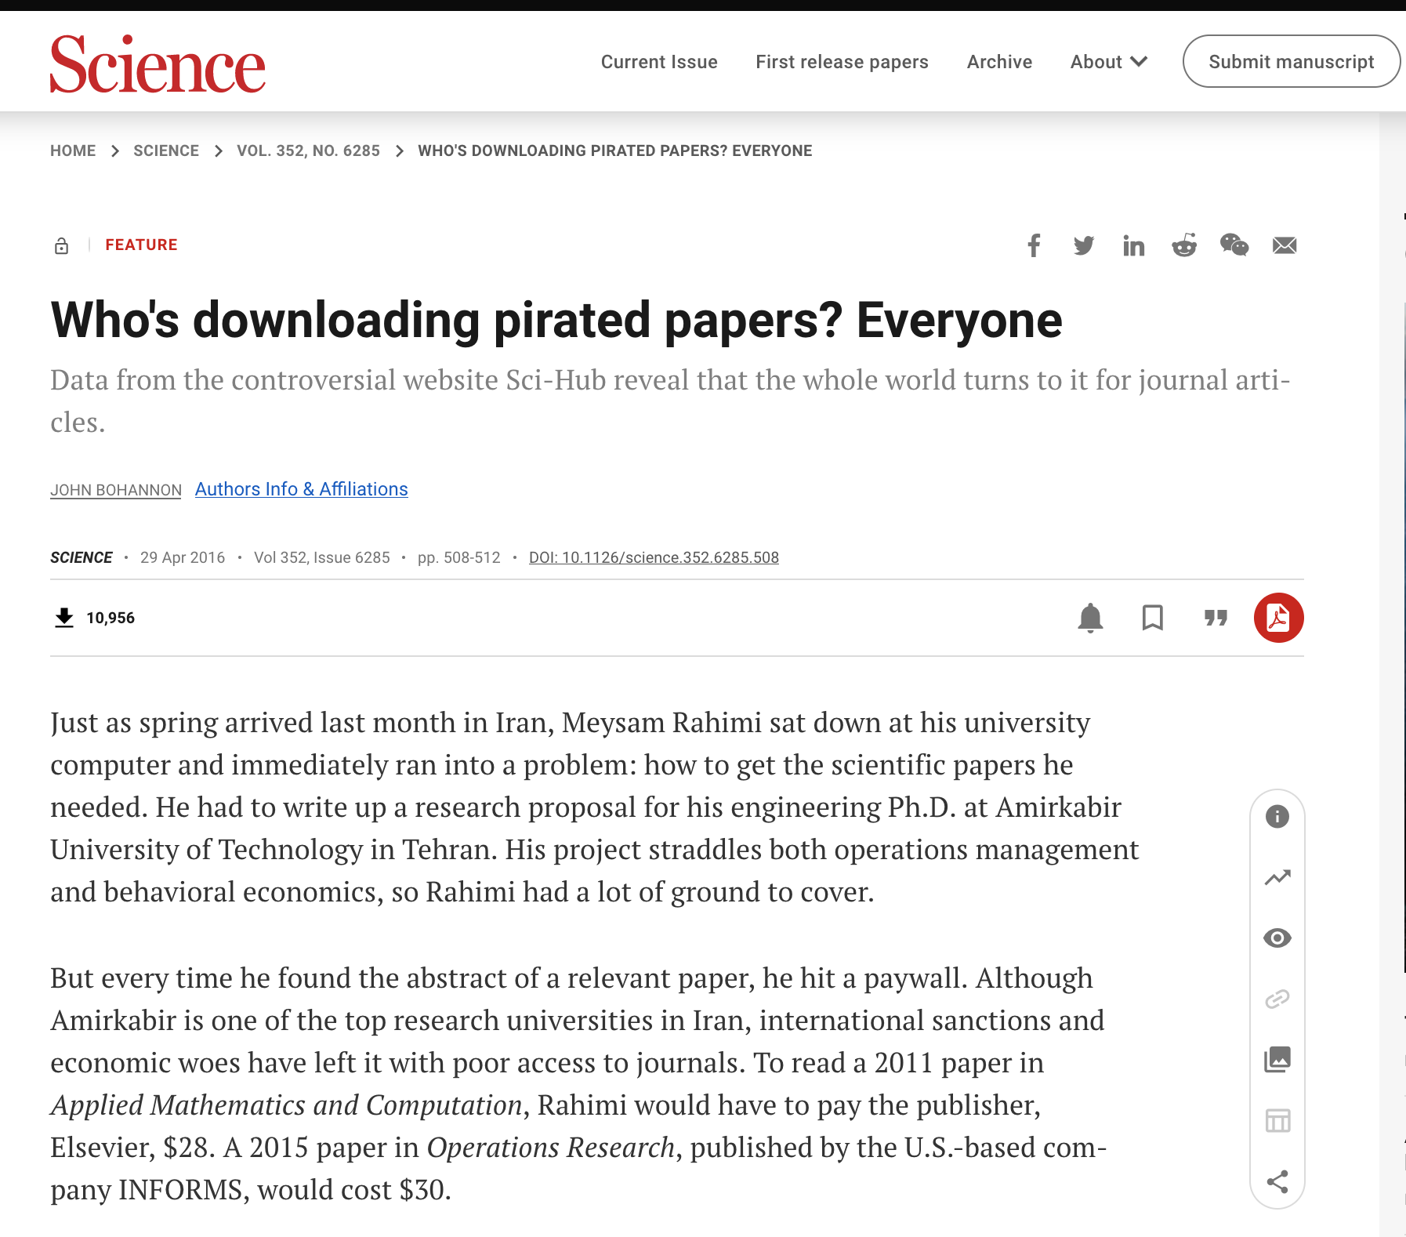
My Origin Story…
Was lookup up Sci-Hub shenanigans
Came across ‘legitimate’ research on it
Notes:
https://www.science.org/doi/10.1126/science.352.6285.508

Slide 3
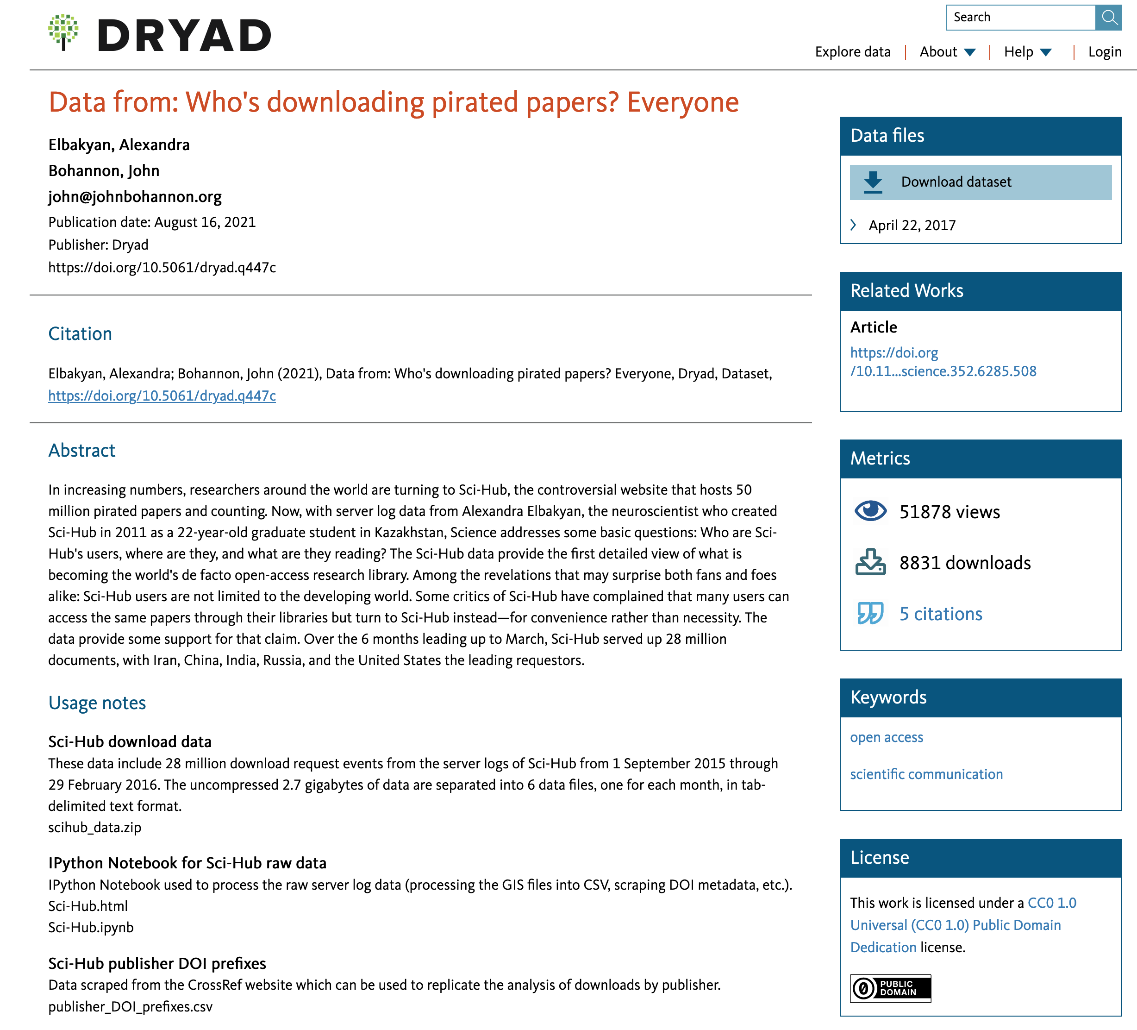
My Origin Story…
Found a link to a data record
Some files!
I could re-use those!

Slide 4
Jupyter!
You’ll quickly learn that I am huge fan of Jupyter in all of its different flavours
Works really good as both a teaching and research environment

Slide 5
Jupyter! – Use Cases
Teaching
Provides a structured code environment that you can share with learners
For example, can provide half completed code and ask them to fill in the details. (*ahem*)
Research
You can do your analysis in a self-documenting process
Mix of Markdown and Code creates a very readable end product.

Slide 6
Jupyter! – Home Machine
- Using something like Anaconda Navigator
CPU
Disk
Data
.
.
.
.
Code
.
.
.
.

Slide 7
Jupyter! – Hosted
- Using something like myBinder or Google Colab
CPU
Disk
Data
.
.
.
.
Code
.
.
.
.

Slide 8
Usability & Jupyter
Our goal then is to save:
Code
Data
Anything else specific to our runtime
So that data reusability is possible:
For verification
Further research
Long term preservation

Slide 9
Part 1 – Saving your project in GitHub
We’ll start from scratch

Slide 10
The ’Research’
We are interested in text sentiment (ie. providing numerical scores on blocks of text to measure how ‘happy’ or ‘negative’ they are)
We are going to use a scoring systems called VADER
Our ‘corpus’ will be a bunch of URLs that we identify

Slide 11
Over to Jupyter

Slide 12
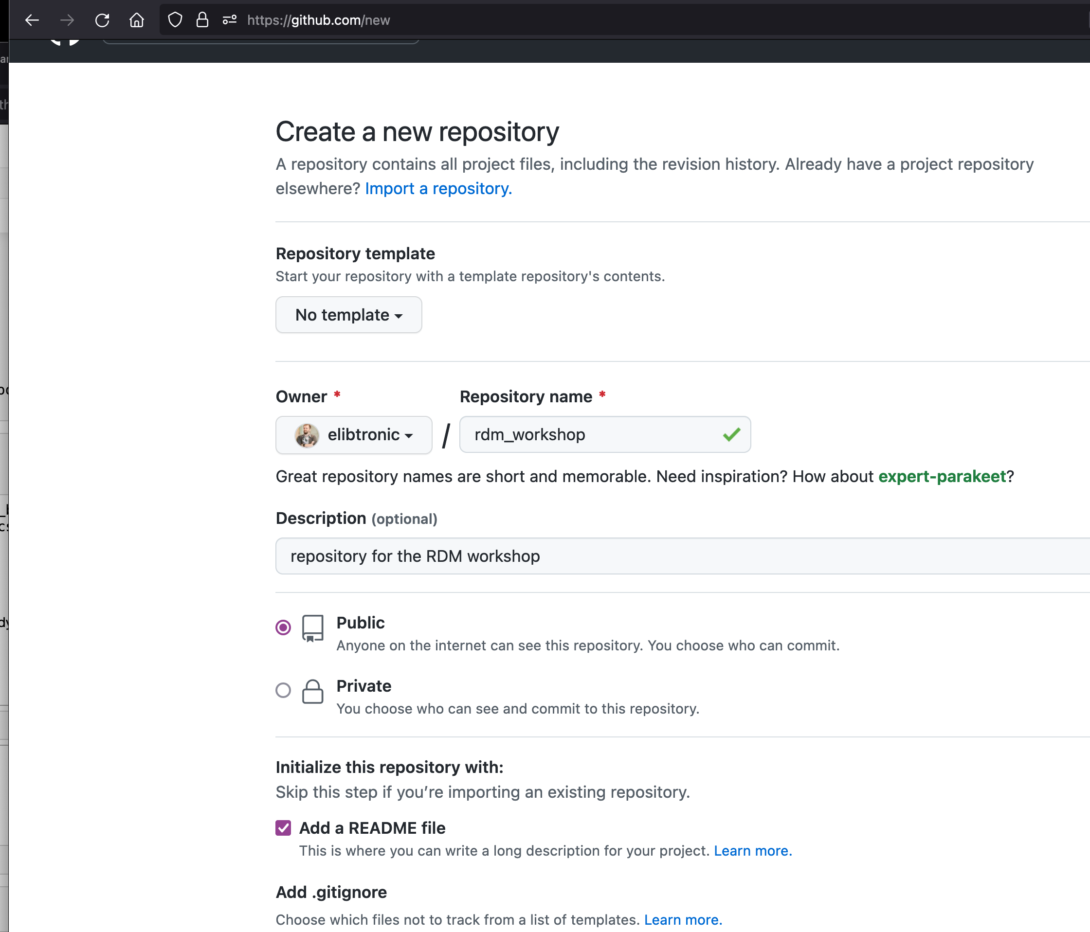
GitHub - Creating a Repository
New Repository
Public
Add a README file
Notes:
https://github.com/new
Options as listed

Slide 13
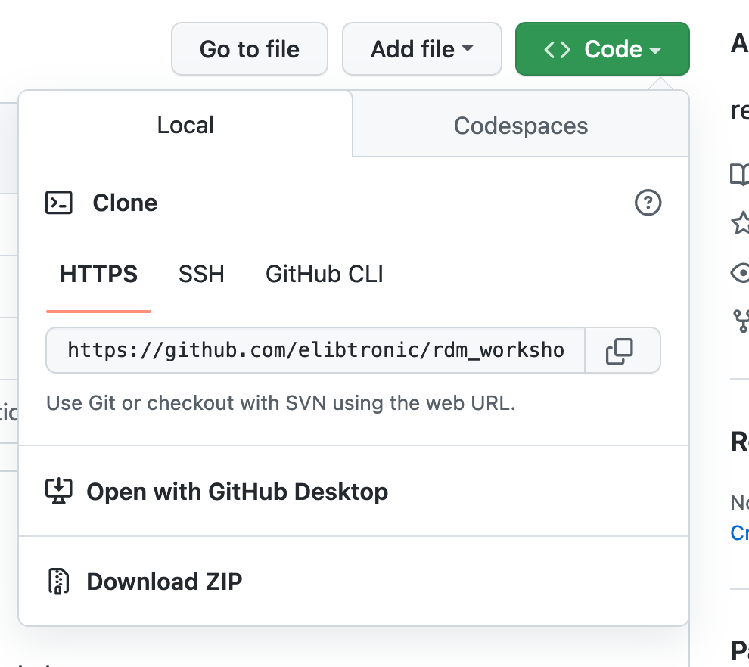
GitHub – Creating a Repository
Notes:
Once repository webpage opens...
Click green <> Code button
Click the two overlapping squares to copy this url
Switch back to Jupyter and add that URL to the appropriate cell

Slide 14
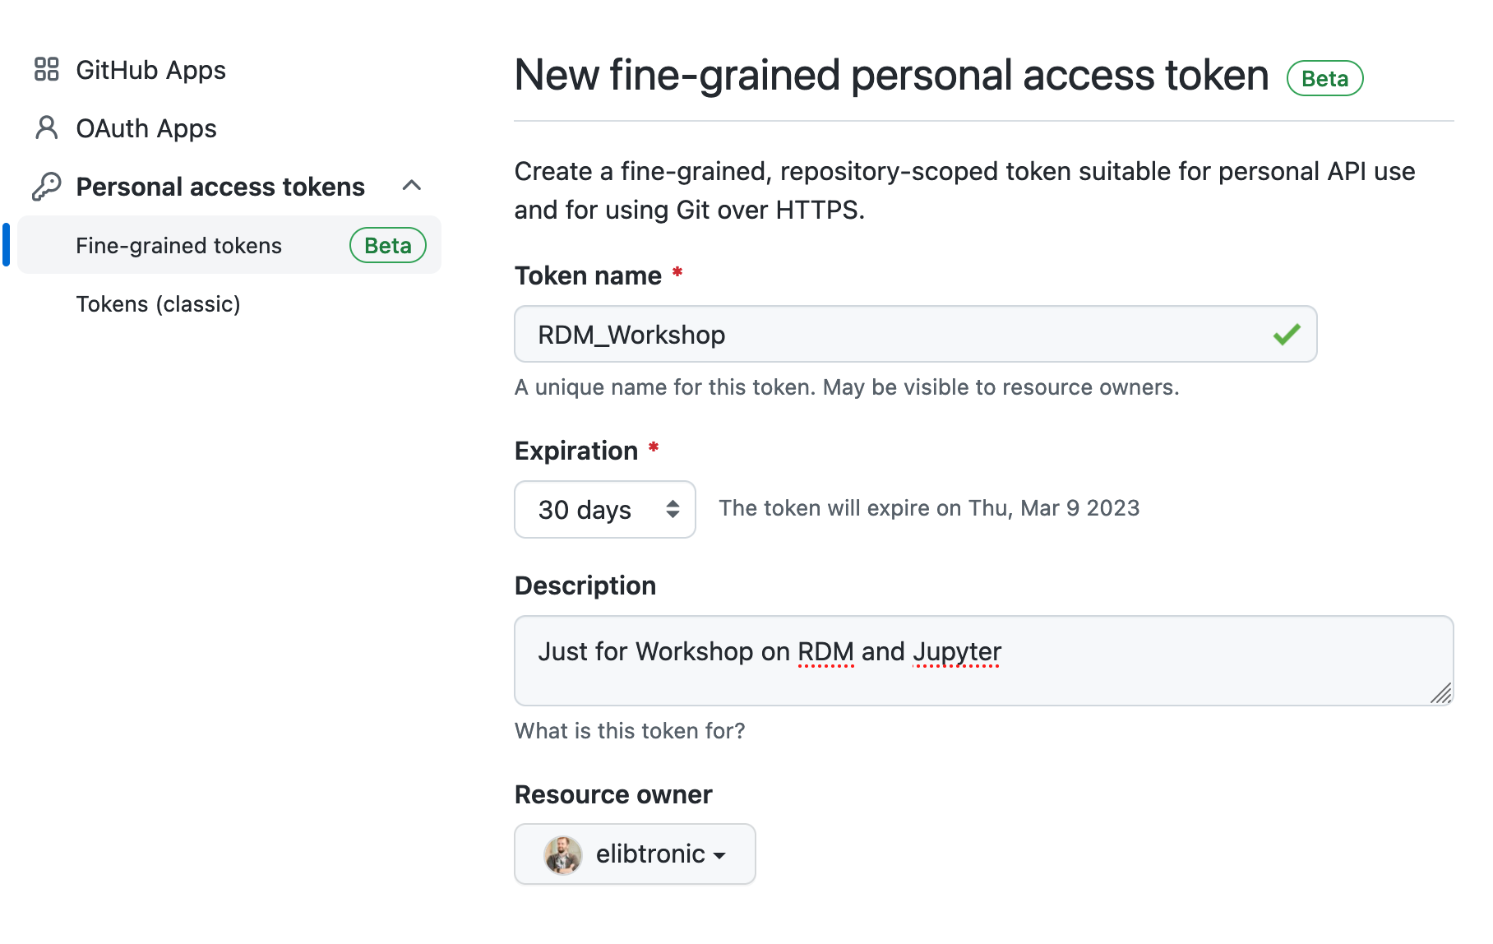
GitHub – Creating an access token
Notes:
https://github.com/settings/apps
Personal access tokens
Fine-grained tokens

Slide 15
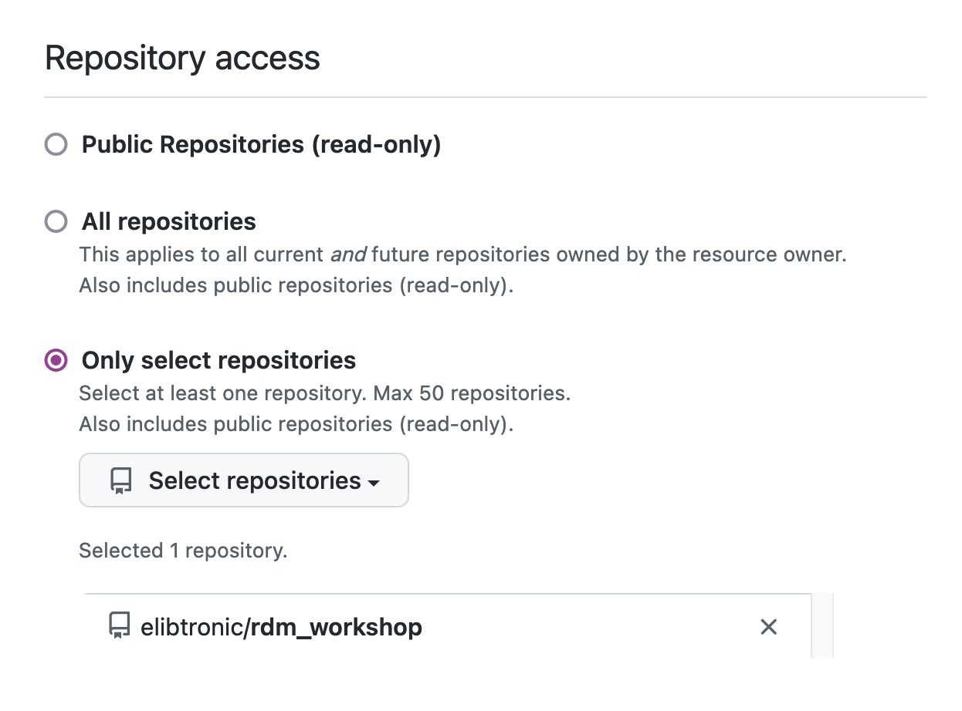
GitHub – Creating an access token
Notes:
We want to restrict it to the repository we just created.
Only selected repositories
Select repository just made

Slide 16
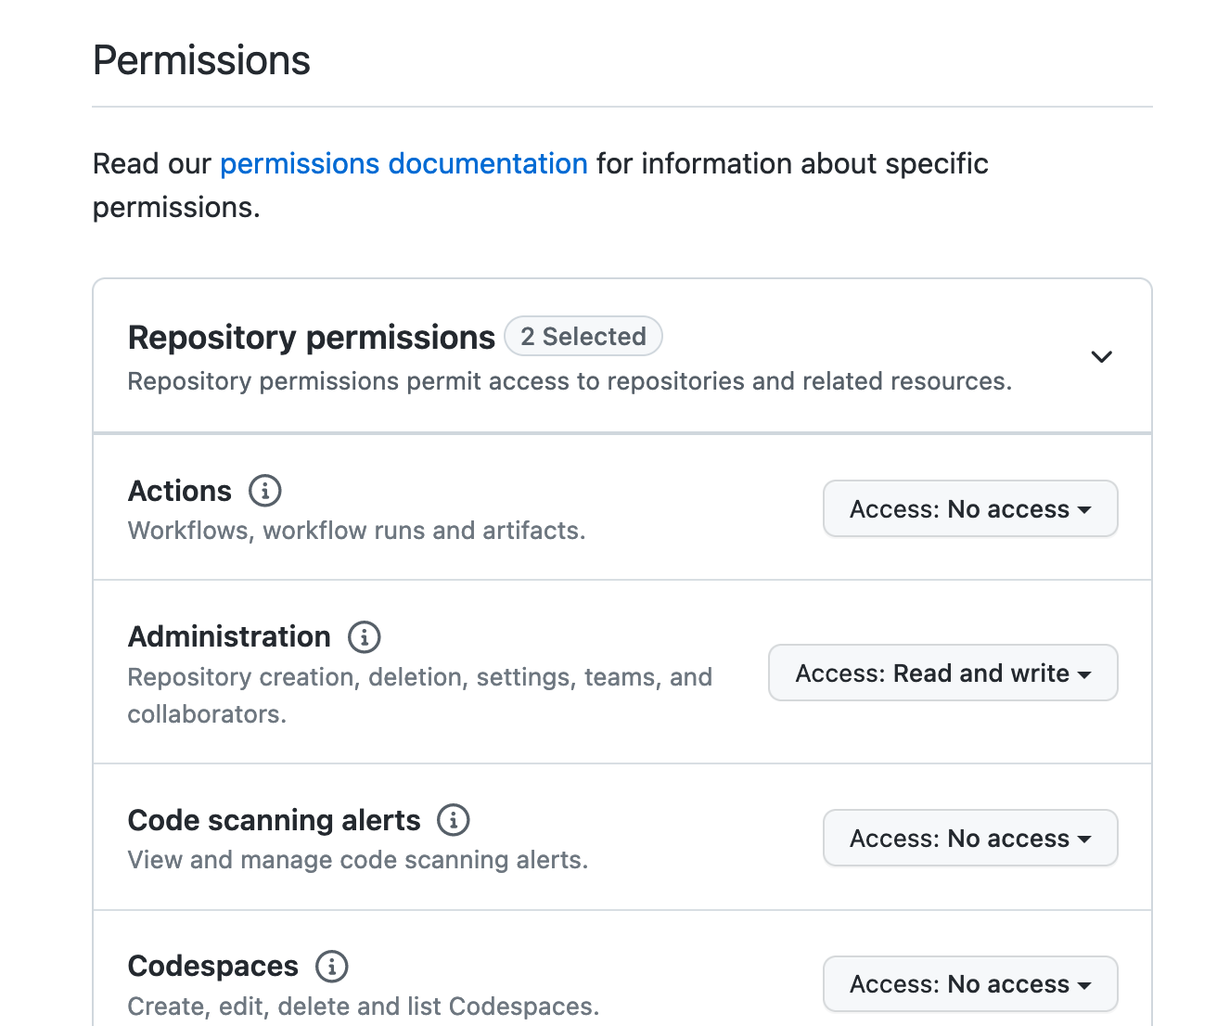
GitHub – Creating an access token
Notes:
Set permissions
In the Administration section change to Access: Read and Write

Slide 17
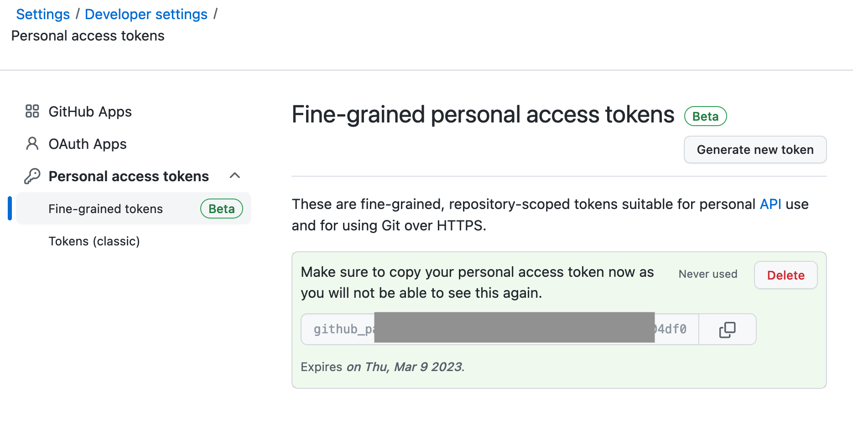
GitHub – Creating an access token
Notes:
Your token will now be visible.
Click the double squares to copy your token
Paste it into the notebook at the right spot.

Slide 18
Part 2 – Reproducing a Project
And maybe submitting a pull request

Slide 19
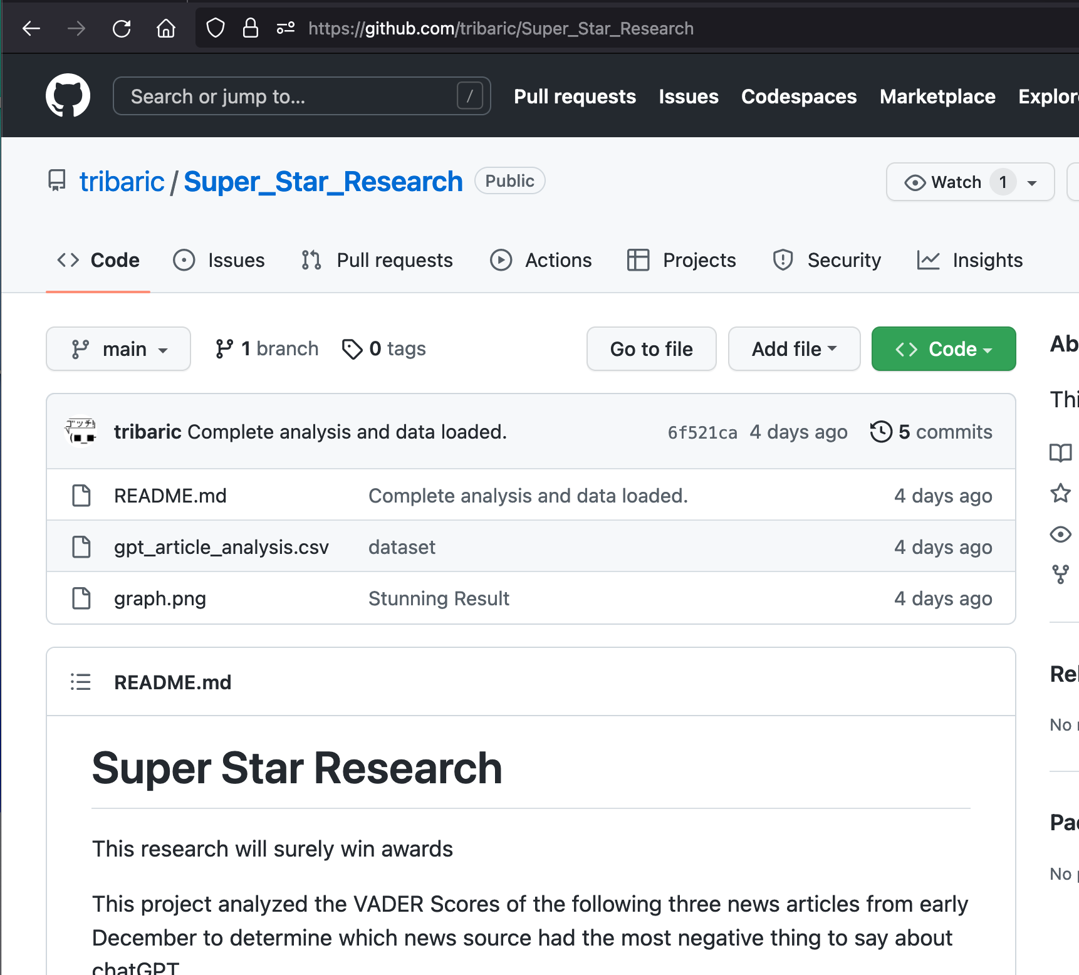
Someone’s been bragging…
You’ve heard from colleagues a rival research lab has found a result that looks suspicious
Let’s look at the repository and see what is going on
Notes:
https://github.com/tribaric/Super_Star_Research

Slide 20
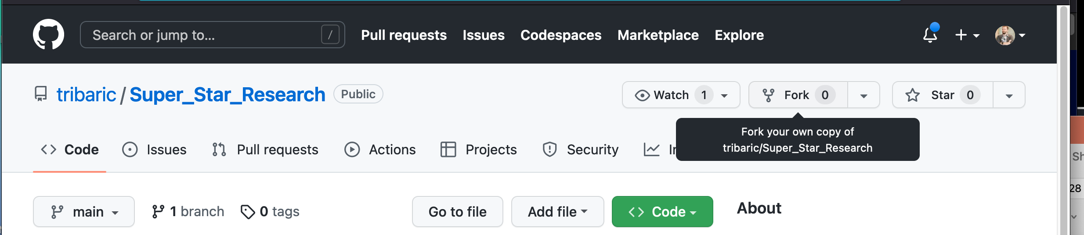
Let’s fix the error
We’ll ‘Fork’ the Repository

Slide 21
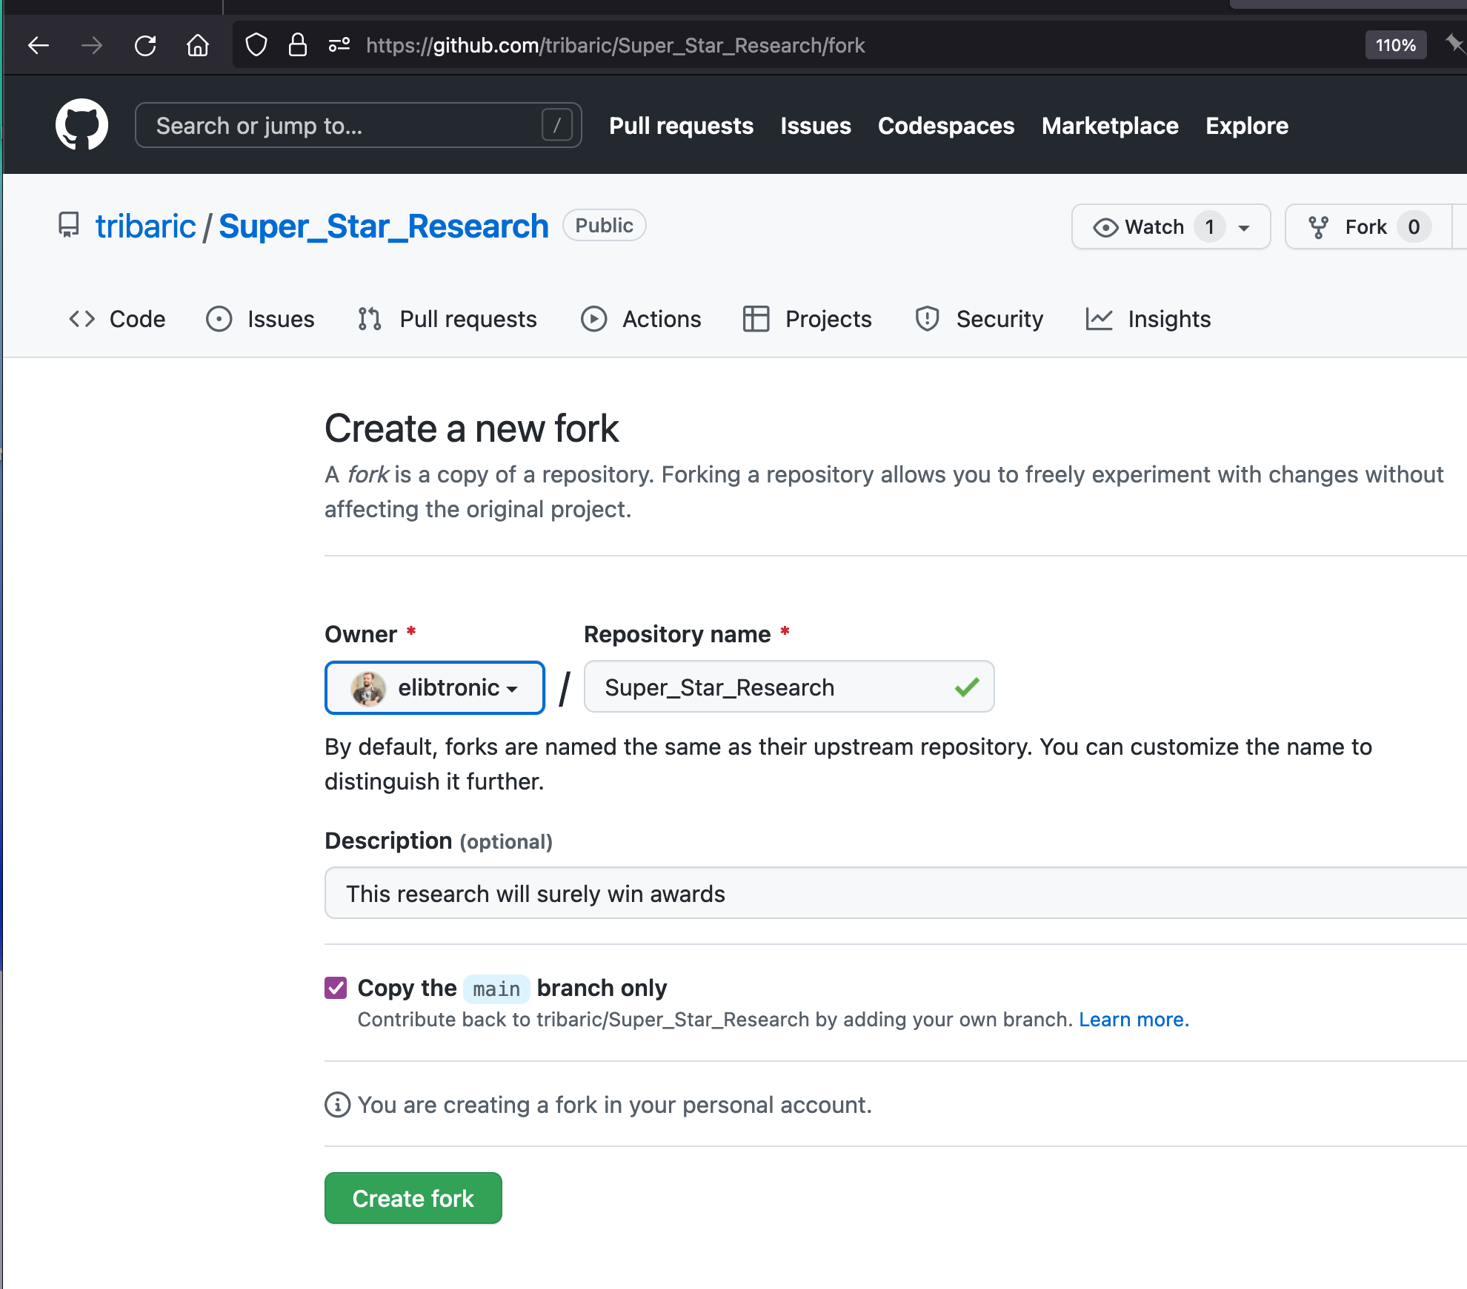
Let’s fix the error
Default options should be fine

Slide 22
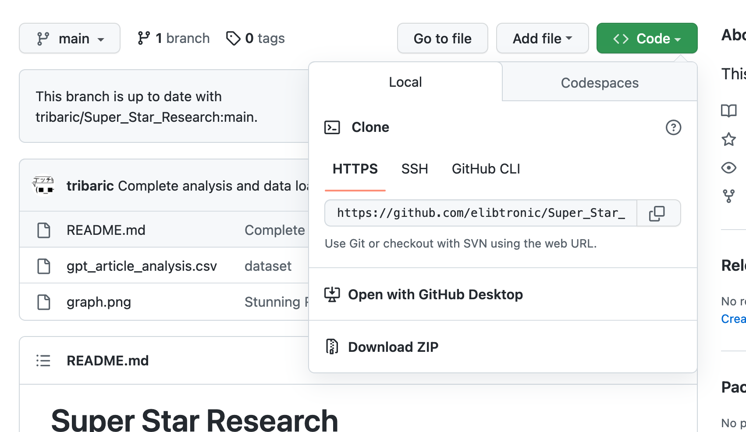
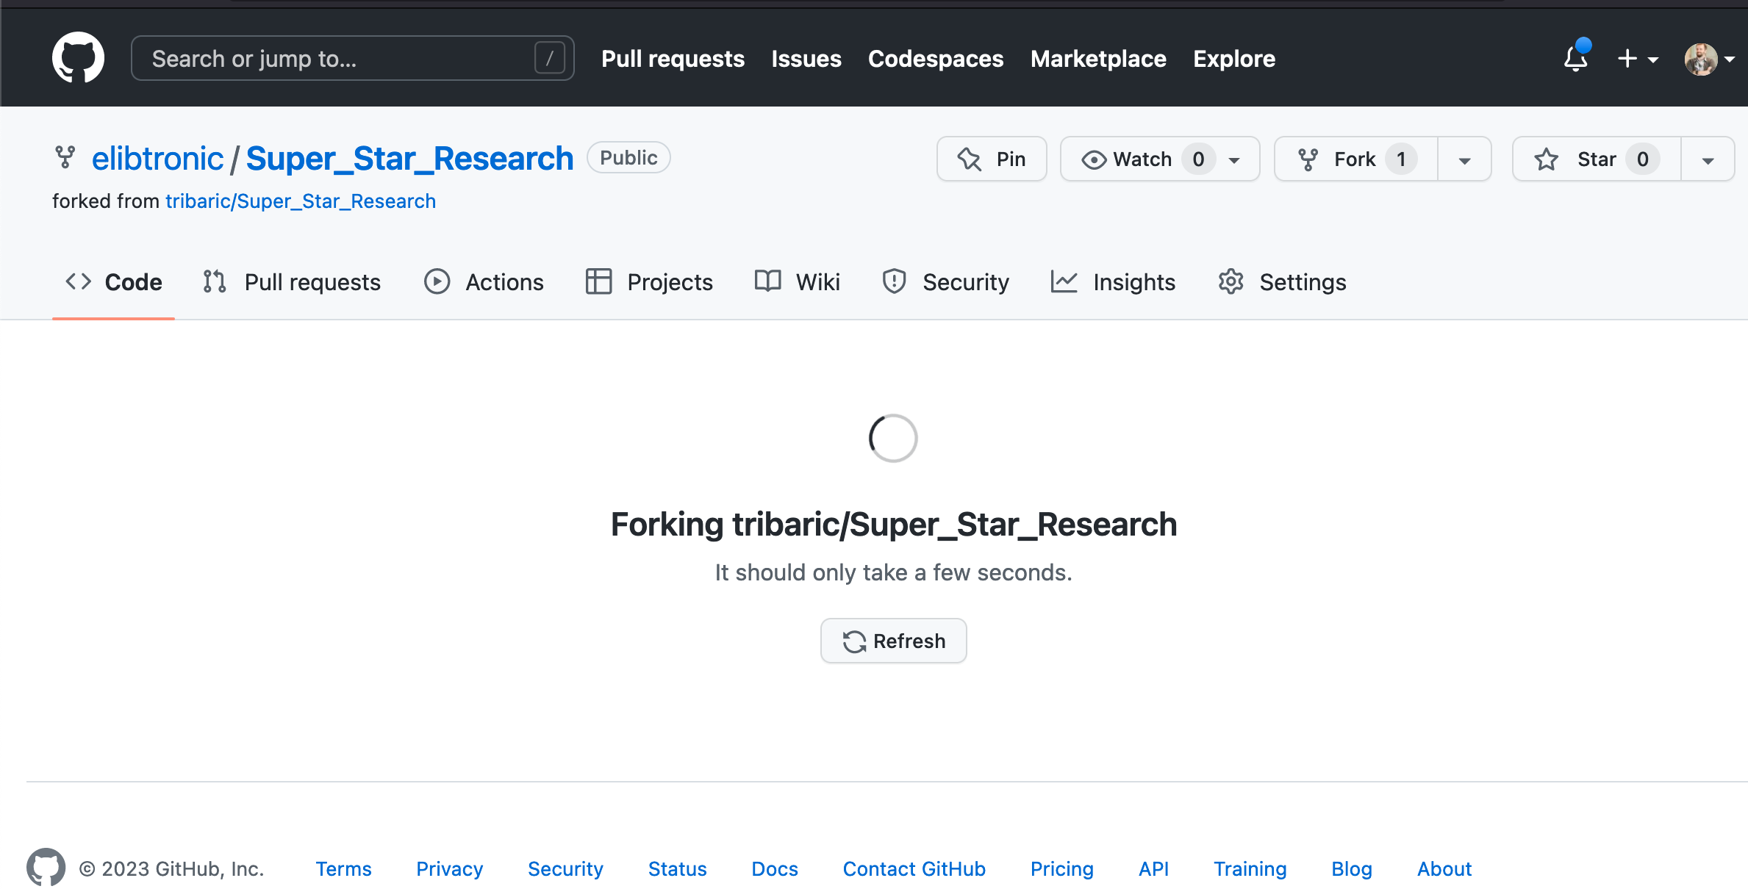
Let’s fix the error
Notes:
Just like part 1, when the fork is done, copy the URL and we can move to our notebook

Slide 23
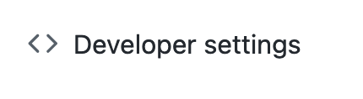
GH Token – again
We will generated a new token for this part of the workshop as well.
Navigate to your profile
Click ‘Developer settings’

Slide 24
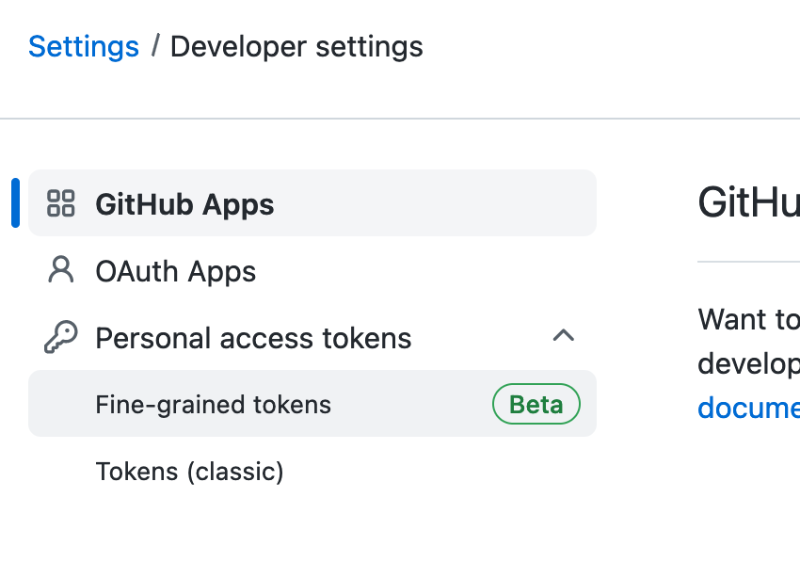
GH Token - again

Slide 25
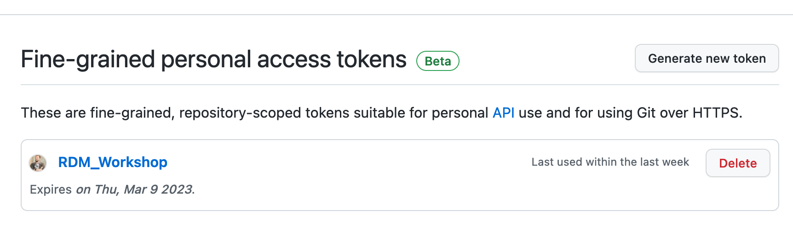
GH Token - again

Slide 26
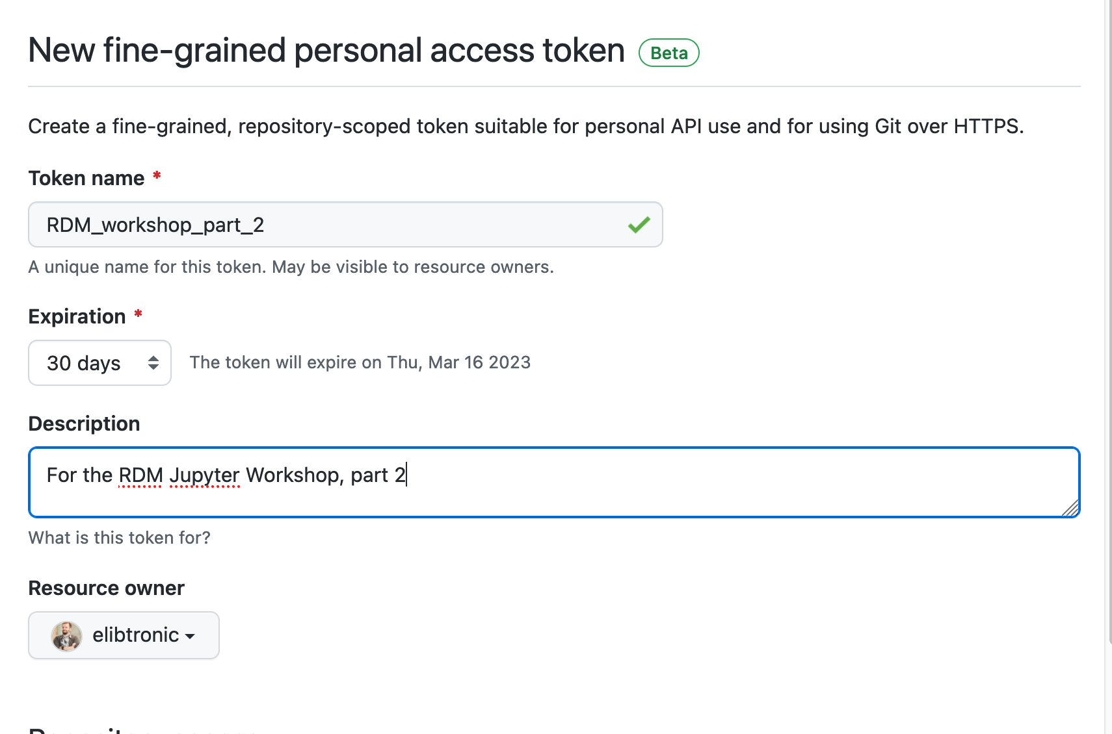
GH Token - again

Slide 27
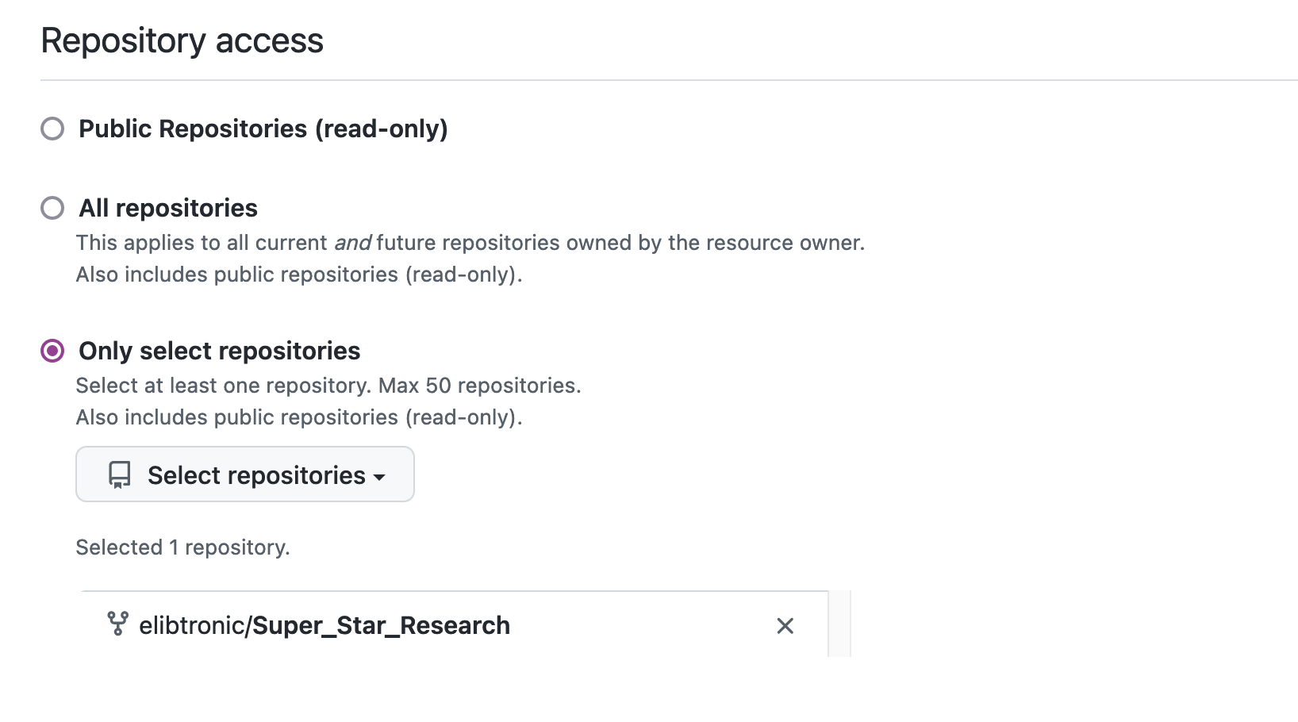
GH – Token - again

Slide 28
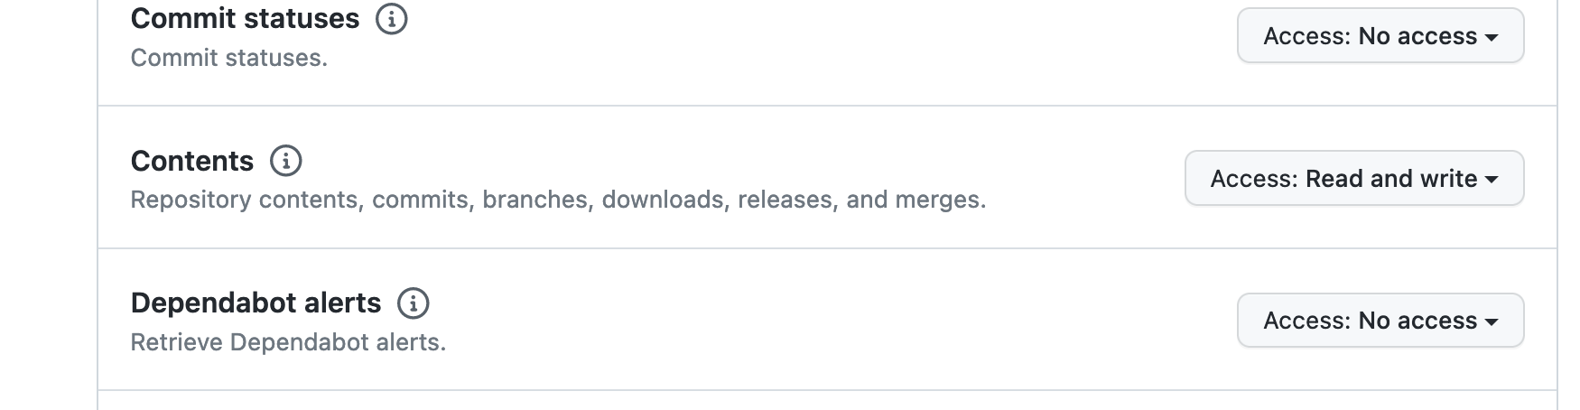
GH Token - again

Slide 29
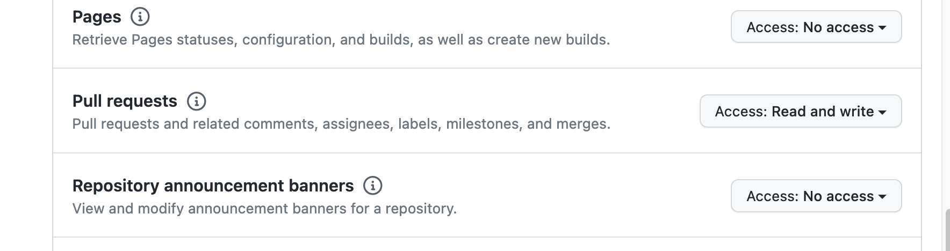
GH Token - again

Slide 30
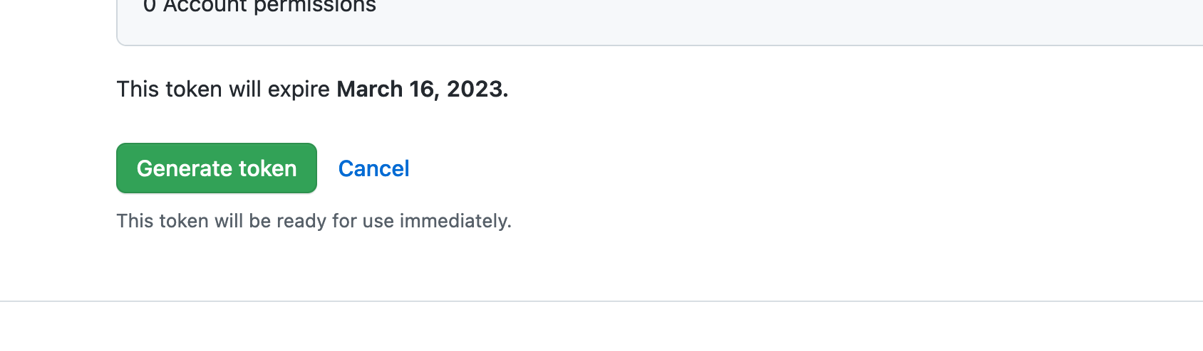
GH Token - again

Slide 31
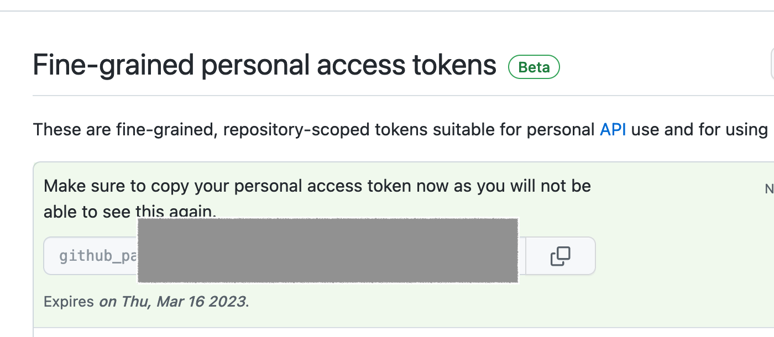
GH Token - again
Notes:
Click the two squares to copy your token.

Slide 32
Fire up the Notebook
part2.ipynb

